Slide 1
Graphs
CSE 2050
Ahmad Jbara
University of Connecticut

Slide 2
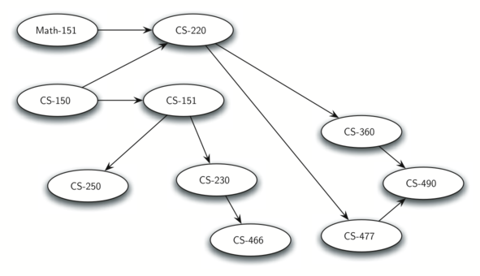
Graphs
Graphs are a more general structure than trees
We can think of a tree as a special kind of graph
Can be used to represent many things about the world
Systems of roads
Airline flights from city to city
How the Internet is connected
Classes you need to take to complete a major in CS

Slide 3
Graphs
Formally, a graph is a pair (V, E) where
V is the vertex set
E is the edge set
Example
G = ({1,2,3,4}, {(1,2), (1,3), (1,4)})

Slide 4
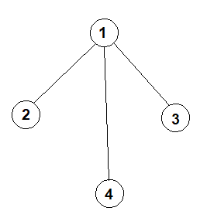
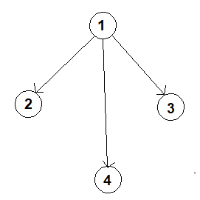
Graphs
Formally, a graph is a pair (V, E) where
V is the vertex set
E is the edge set
Example
G = ({1,2,3,4}, {(1,2), (1,3), (1,4)})
tuple
set
set
V
E
undirected
directed

Slide 5
Graphs
A simple graph
A graph without self loops
A graph without multiple edges between the same pair of vertices
Undirected graph
A graph where the ordering of the vertices in an edge does not matter
Edges are two way
Directed graph - digraph
A graph where the ordering of the vertices in an edge does matter
Edges are one-way
Adjacent vertices
If two vertices are connected by an edge they are adjacent

Slide 6
The Graph (directed) ADT
Graph ADT supports the following operations
Operation | Description
Graph() | creates a new empty graph
addVertex(vert) | Adds a new vertex to the graph
addEdge(from, to) | Adds a new directed edge that connects two vertices
vertices() | Returns a collection of all vertices
edges() | Returns a collection of all edges
nbrs(v) | Returns a collection of the out neighbors of v
removeVertex(vert)
removeEdge(from, to)

Slide 7
Implementation using set – directed
class EdgeSetGraph:
def __init__(self, V, E):
self._V = set()
self._E = set()
for v in V: self.addvertex(v)
for u,v in E: self.addedge(u,v)
def vertices(self):
return iter(self._V)
def edges(self):
return iter(self._E)
def addvertex(self, v):
self._V.add(v)
def addedge(self, u, v):
self._E.add((u,v))
def nbrs(self, v):
return (w for u,w in self._E if u == v)

Slide 8
Implementation using set – undirected
class UndirectedEgeSetGraph (EdgeSetGraph):
def addedge(self, u, v):
self._E.add((u,v))
self._E.add((v,u))
# Please check if other methods need to be changed

Slide 9
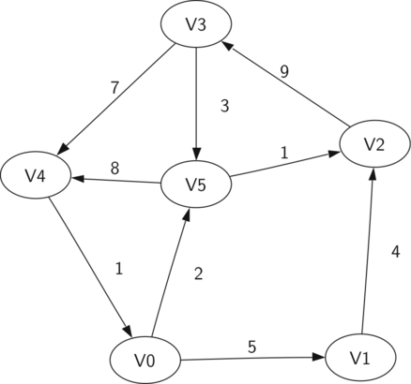
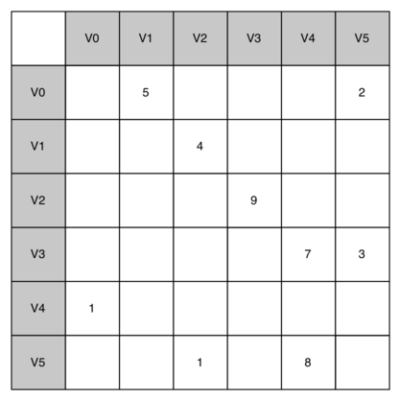
Implementation using an adjacency matrix
One way to implement a graph is to use two-dimensional matrix
Each of the rows and columns represent a vertex
The intersection (cell) of row v and column u indicates if there is an edge from v to u
If v and u are connected by and edge we say they are adjacent

Slide 10
Implementation using an adjacency matrix
Advantages
Simple
Easy to see which vertices are adjacent
It is good when the number of edges is large – dense graph
Disadvantages
Most cells are empty – sparse matrix
Matrix is not so efficient to store sparse data

Slide 11
Implementation using adjacency set
Get neighbors in previous implementation
We go through all edges to find neighbors of a given vertex
Alternative approach
Store neighbors of each vertex
Allows for fast access to the neighbors
We don’t need to stores edges
Compact representation for sparse graphs

Slide 12
Implementation using adjacency set
class AdjacencySetGraph:
def __init__(self, V, E):
self._V = set()
self._nbrs = {}
for v in V: self.addvertex(v)
for u,v in E: self.addedge(u,v)
def vertices(self):
return iter(self._V)
def edges(self):
for u in self._V:
for v in self.nbrs(u):
yield (u,v)
. . .
def addvertex(self, v):
self._V.add(v)
self._nbrs[v] = set()
def addedge(self, u, v):
self._nbrs[u].add(v)
def nbrs(self, v):
return iter(self._nbrs[v])
def hasedge(self, u, v):
return v in self._nbrs[u]
G = AdjacencySetGraph({1,2,3}, {(1,2),(2,1),(1,3)})
print("neighbors of 1:", list(G.nbrs(1)))
print("neighbors of 2:", list(G.nbrs(2)))
print("neighbors of 3:", list(G.nbrs(3)))

Slide 13
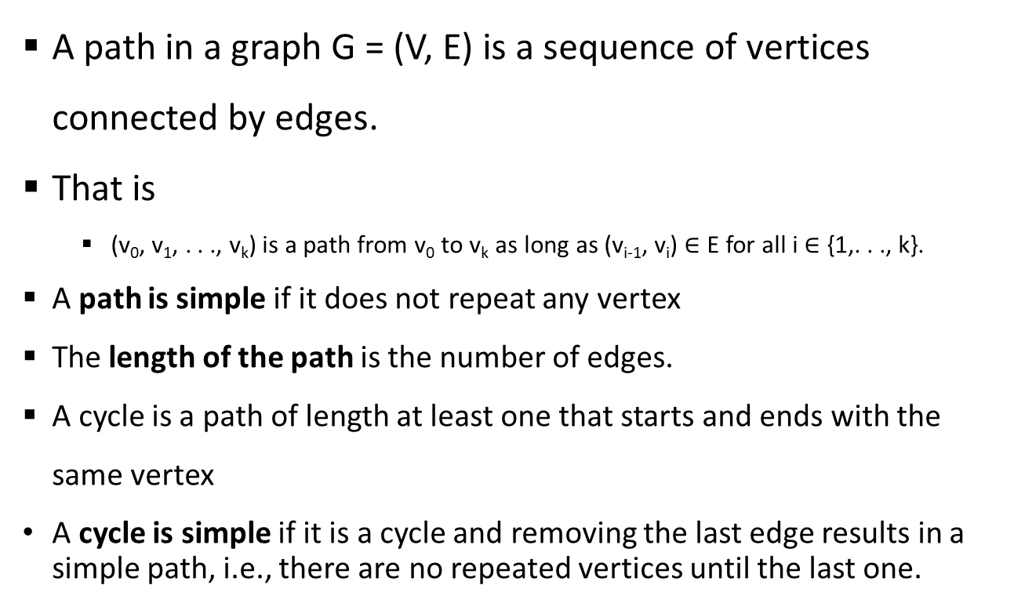
Paths and Connectivity
A path in a graph G = (V, E) is a sequence of vertices connected by edges.
That is
(v₀, v₁, . . ., v_{k}) is a path from v₀ to v_{k} as long as (v_{i-1}, v_{i}) $∈$ E for all i $∈$ {1,. . ., k}.
A path is simple if it does not repeat any vertex
The length of the path is the number of edges.
A cycle is a path of length at least one that starts and ends with the same vertex
A cycle is simple if it is a cycle and removing the last edge results in a simple path, i.e., there are no repeated vertices until the last one.

Slide 14
Paths and Connectivity – related functions
def ispath(G, V):
return V and all(G.hasedge(V[i‑1], V[i]) for i in range(1, len(V)))
def issimplepath(G, V):
return ispath(G, V) and len(V) == len(set(V))
def iscycle(G, V):
return ispath(G, V) and V[0] == V[‑1]
def issimplecycle(G, V):
return iscycle(G,V) and issimplepath(G, V[:‑1])

Slide 15
Paths and Connectivity
A vertex u is connected to v if there exists a path that starts at u and ends at v
In undirected graph, if u is connected to v, then v is connected to u
In a directed graph, two vertices u and v are strongly connected if u is connected to v and also v is connected to u

Slide 16
Paths and Connectivity
class AdjacencySetGraph:
. . .
def connected(self, a, b):
if a == b:
return True
return any(self.connected(nbr, b) for nbr in self.nbrs(a))
G = AdjacencySetGraph({1,2,3}, {(1,2), (2,3)})
assert(G.connected(1,2))
assert(G.connected(1,3))
assert(not G.connected(3,1))
print("First graph is okay.")
H = AdjacencySetGraph({1,2,3}, {(1,2), (2,1), (2,3)})
try:
H.connected(1,3)
except RecursionError:
print("There was too much recursion!")

Slide 17
Paths and Connectivity
def connected(self, a, b):
return self._connected(a, b, set())
def _connected(self, a, b, visited):
if a in visited: return False
if a == b:
return True
visited.add(a)
return any(self._connected(nbr, b, visited) for nbr in self.nbrs(a))

Slide 18
Graph search – depth first search
def dfs(self, v):
tree = {}
tovisit = [(None, v)]
while tovisit:
a,b = tovisit.pop()
if b not in tree:
tree[b] = a
for n in self.nbrs(b):
tovisit.append((b,n))
return tree

Slide 19
Graph search – depth first search
def dfs(self, v):
tree = {}
tovisit = [(None, v)]
while tovisit:
a,b = tovisit.pop()
if b not in tree:
tree[b] = a
for n in self.nbrs(b):
tovisit.append((b,n))
return tree
def connected(G, u, v):
return v in G.dfs(u)

Slide 20
Graph search – breadth - first search
def bfs(self, v):
tree = {}
tovisit = Queue([(None, v)])
while tovisit:
a,b = tovisit.dequeue()
if b not in tree:
tree[b] = a
for n in self.nbrs(b):
tovisit.enqueue((b,n))
return tree

Slide 21
Graph search – shortest path
def distance(G, u, v):
tree = G.bfs(u)
if v not in tree:
return float('inf')
edgecount = 0
while v is not u:
edgecount += 1
v = tree[v]
return edgecount

